Slide 1
Potential Aquatic Resource Mitigation Sites for Southeast Alaska
Notes:
I changed restoration to Aquatic Resource Mitigation Sites:
Including, restoration, enhancement, and creation

Slide 2
Goals of Project:
Develop a tool to support SAWC to identify, rapidly assess and map potential mitigation projects in Southeast Alaska
Create a database to store mitigation site information and data
Utilize tool and conduct assessments in the communities of Haines, Skagway and Juneau
Notes:
In this slide we need to talk about the different aspects of the assessment tool and what you based the information off of. I think it would be really good to bring in a few of the assessment forms so people can look at them while you are talking about them.

Slide 3
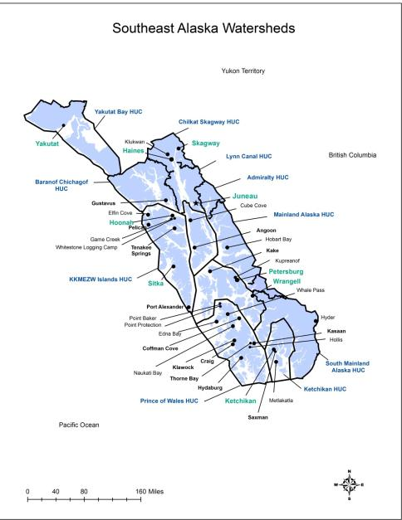
Study Area: Southeast Alaska
Notes:
We could get a much more close up map of northern lynn canal. These folks will know the area

Slide 4
Outcomes of Project:
Compiled a list of potential mitigation projects
Developed and field tested a standardized assessment form and project vignettes
Generated a template of a user-friendly map on Google Earth*
Completed site assessments and project reports in Skagway, Haines and Juneau
Utilized GIS layers to understand potential functions of sites
Notes:
In this slide be very specific… what were the results: how many sites? What resources did you use to develop the form… Remind me to bring up the Google Earth– maybe this can be developed once the mitigation sites are under SAWC ownership… Did you produce relational data that shows the potential functional lift at each mitigation site????

Slide 5
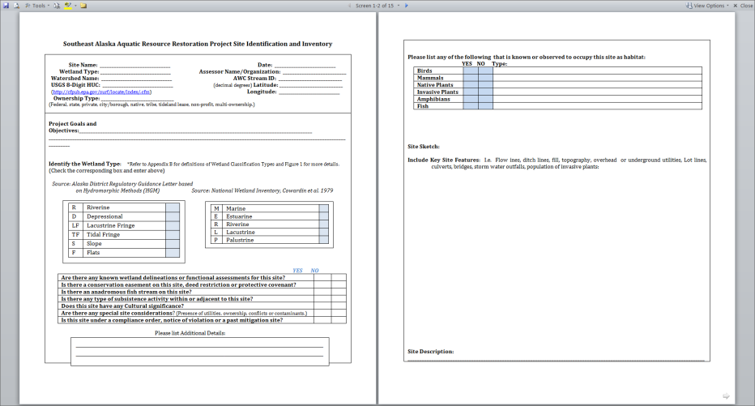
Mitigation Site Assessment Form
Notes:
Lets have a copy for people to look at

Slide 6
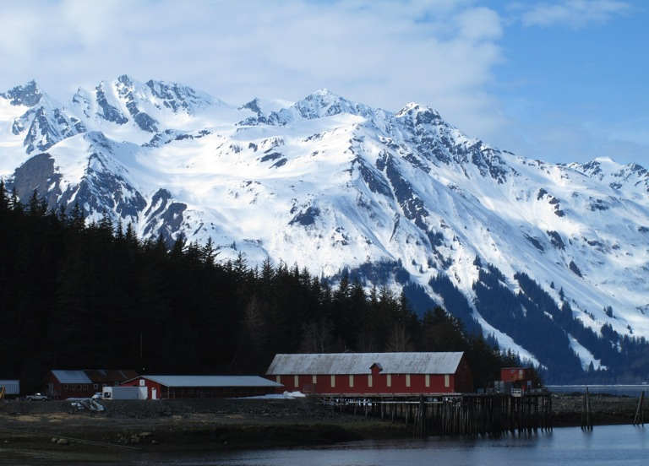
Haines
Notes:
Explain local connections to seek out information on sites!

Slide 7
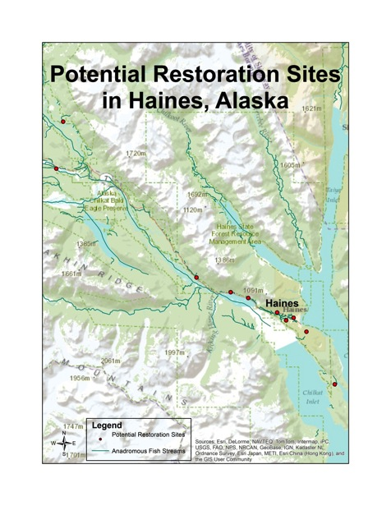
10 sites have been identified

Slide 8
Identified Restoration Projects in Haines
RESTORATION SITES | LATITUDE | LONGITUDE | WETLAND TYPE | SIZE (acres) | HUC
PORCIPINE BRIDGE POND | 59.411361 | -136.002845 | R3USC, Riverine Upper Perennial Unconsolidated Shore Seasonally Flooded | 8 | 1901030310
7 ECHOES SITE | 59.157693 | -135.36176 | E2EM1P, Estuarine Intertidal Emergent Persistent Seasonally Flooded |  | 1901031308
SHEEP CANYON LAKE SLOUGH | 59.466352 | -135.987244 | PEM1F, Palustrine Emergent Persistent Temporarily Flooded | 1.1 | 19010303
3-MILE FILL | 59.242371 | -135.494195 | PEM1R, Palustrine Emergent Persistent Seasonally Flooded-Tidal | 1.8 | 1901030313
7-MILE SADDLE TRAIL | 59.266208 | -135.601389 | PSS1C, Riparian Shrub Forest Broad-leaved deciduous seasonally flooded | 0.07 | 1901030313
5-MILE DRIVEWAY | 59.259444 | -135.560833 | PSS1C, Riparian Shrub Forest Broad-leaved deciduous seasonally flooded | 0.0046 | 1901030313
10-MILE FLORESKI PROPERTY | 59.2836 | -135.680153 | PEM1B, Palustrine Emergent Persistent Saturated | 2.01 | 1901030313
DOT CULVERT | 59.236087 | -135.456433 | Stream | 0.04 | 1901031308
JONES POINT SITE | 59.233024 | -135.473507 | Stream | 1.3 | 1901031308
HAINES PRIVATE LANDFILL SITE | 59.219707 | -135.426743 | Palustrine | 0.45 | 1901030313
14-MILE SIDE ROADS |  |  | Riverrine |  | 19010303
HAINES SAWMILL | 59.285311 | -135.479246 | Estuarine-E1UBL |  | 19010303
17-MILE CULVERT |  |  | Riverine |  | 19010303
WELLS BRIDGE | 59.412364 | -135.931716 | GH VHNBC | 1.05 | 19010303
Notes:
This is the database that they all the data from the assessment forms has been uploaded…

Slide 9
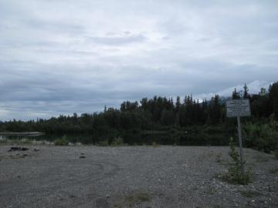
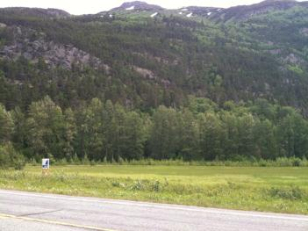
Site Efficacy in Haines
GREEN: No obstacles
YELLOW: Potential obstacles
RED: Major obstacles
Case Study #1
Case Study #2
Porcupine Bridge Fill Site
10-Mile Fill Site
“GREEN”
“YELLOW”

Slide 10
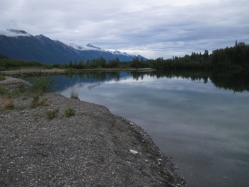
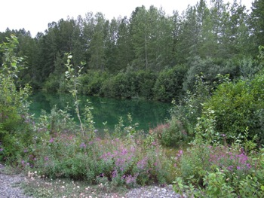
Case Study #1:
Porcupine Pond Site
Located 26 miles north of Haines on Haines Highway

Slide 11
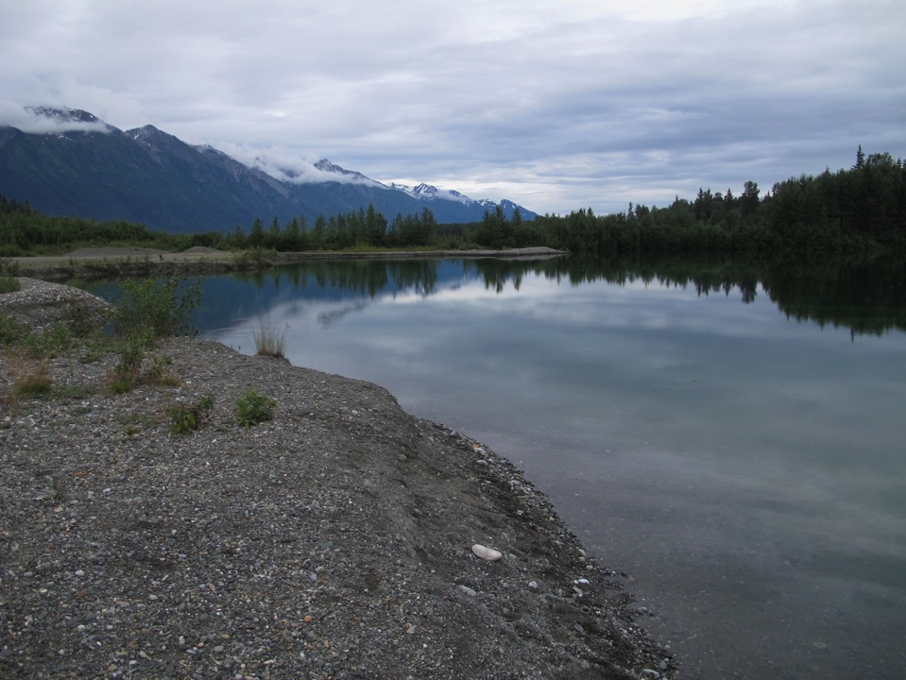
Reasons this site was chosen:
Located adjacent to an anadromous fish stream
No major obstacles
Owned by the Alaska State Parks
Straight forward project goals and objectives
Notes:
What do you want to tell this group about the sites- maybe you could talk briefly about why this is a green site and touch a bit on the idea that many sites were identified but few would be ready to go… because,….

Slide 12
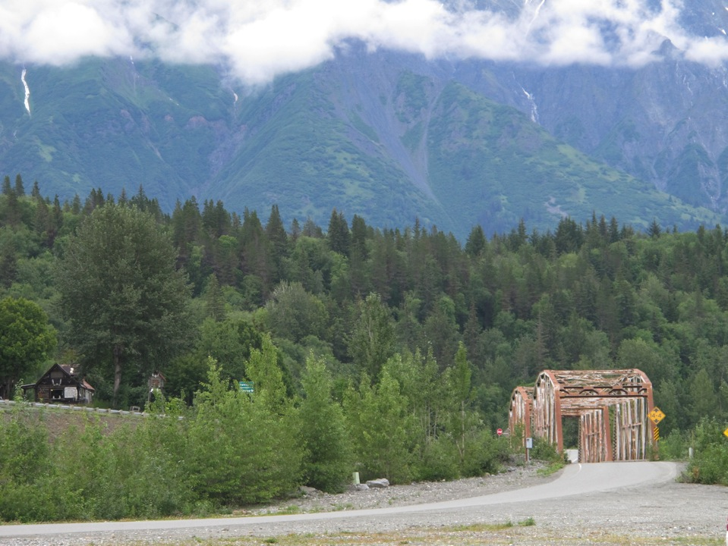
Goal of Potential Restoration Project:
Improve rearing habitat for salmonids and maintain productivity of amphibians.

Slide 13
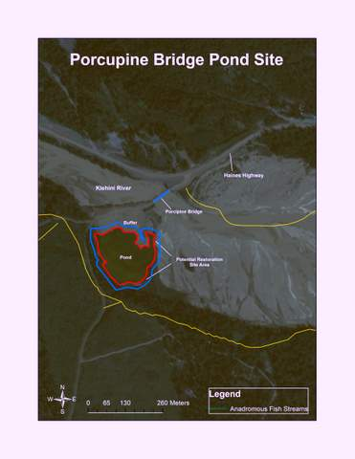
Map of Porcupine Pond Site
Notes:
You can talk about the maps you are making for each one and I will mention something regarding buffers: The reason we are going to put in buffer– this is a policy question that the IRT needs to begin to address.. A

Slide 14
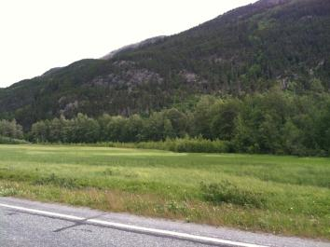
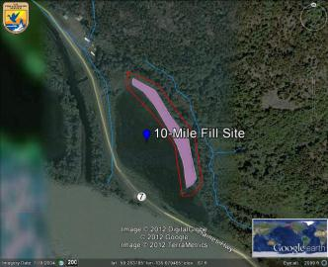
Case Study #2:
10-Mile Fill Site
10-acre Wetland area
2-acre Fill Area

Slide 15
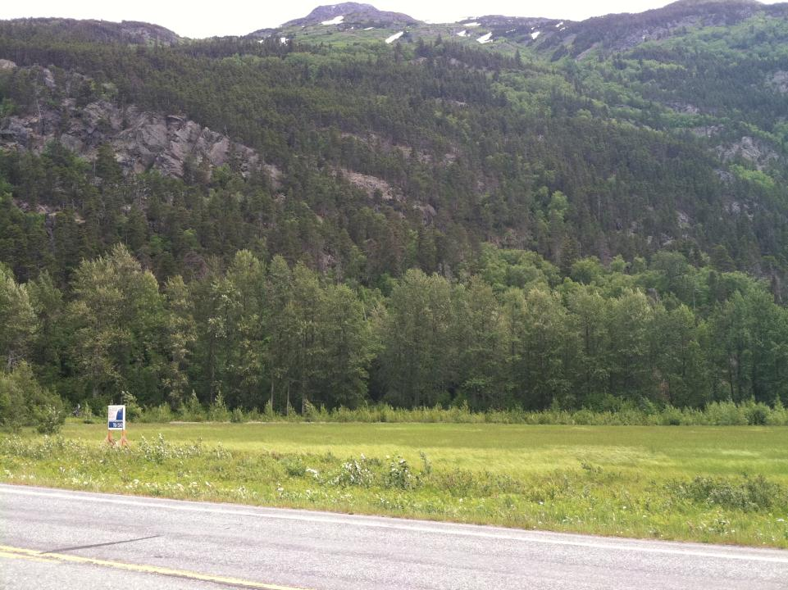
Project Objectives:
1. To remove fill
2. To re-establish vegetation

Slide 16
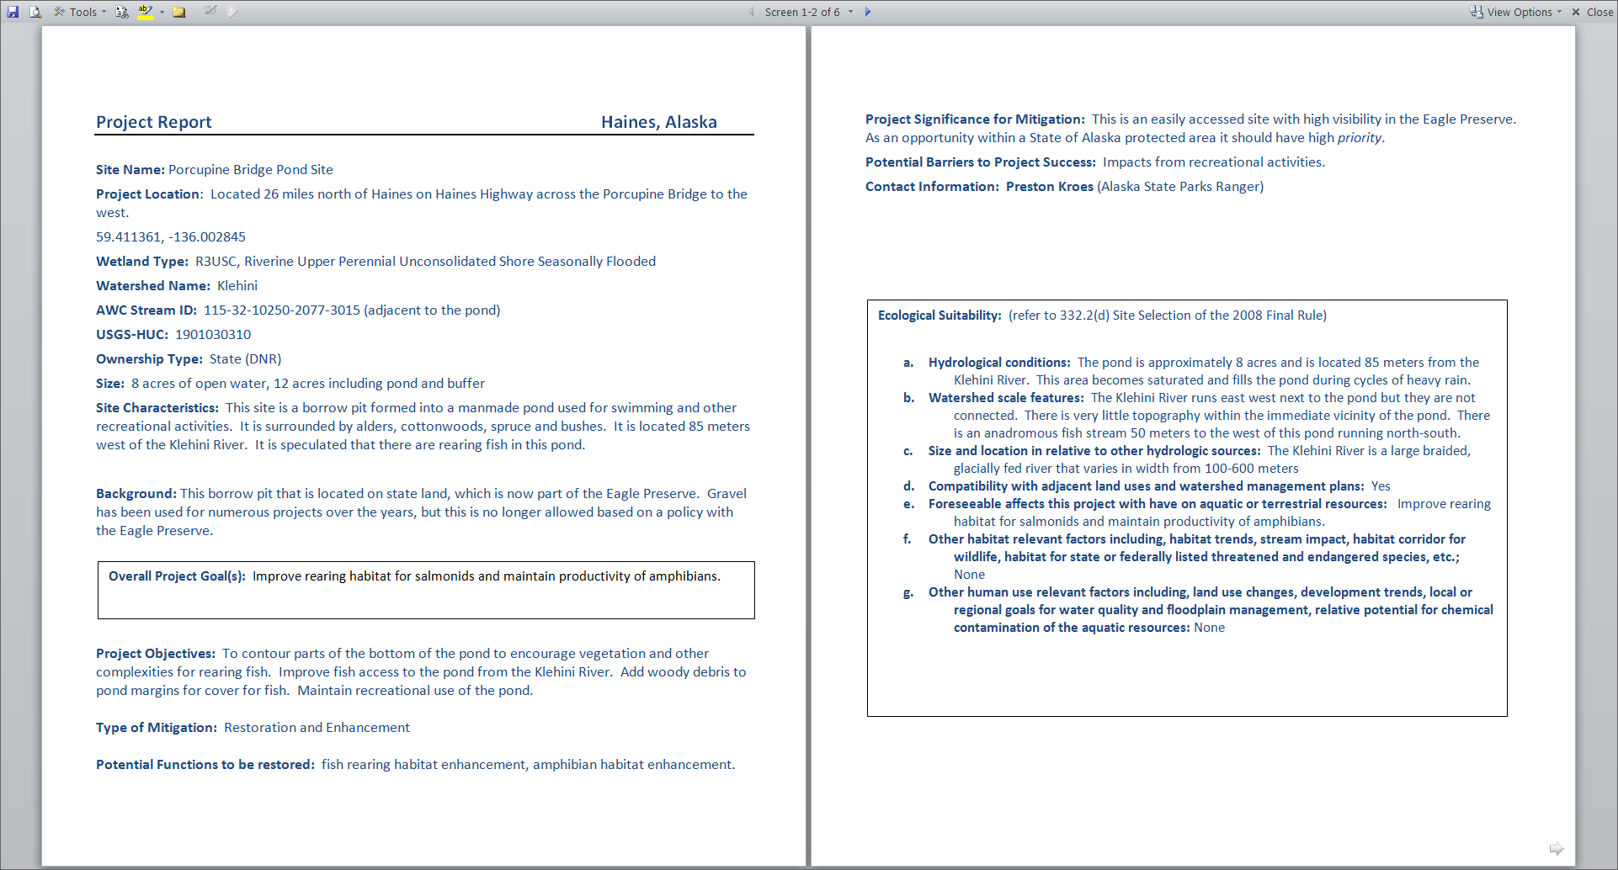
Final Project Report
Notes:
How is this different from the assessment form? Is this the info being stored in the database or is the assessment form data being stored in the database. These are just some things you could talk about regarding this form… not sure what you were going to say

Slide 17
Ecological Suitability of Restoration Sites
Notes:
Mention FINAL RULE. What were you going to say about this… Maybe: we are trying to make this tool user friendly. Therefore we have provided key questions that the assessor can ask if they are out with a technical experty.

Slide 18
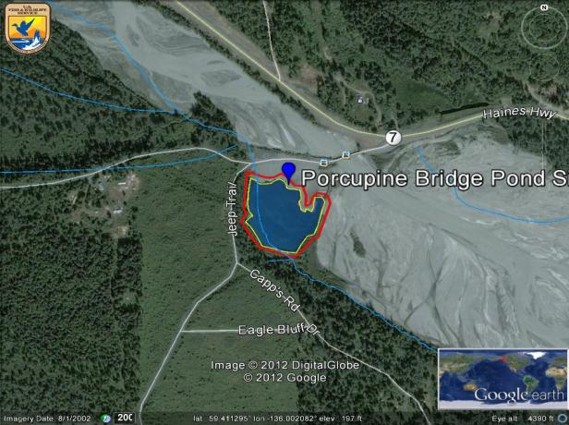
Google Earth Perspective
Notes:
Once this site is owned by SAWC we plan to offer this concept up on Google Earth

Slide 19
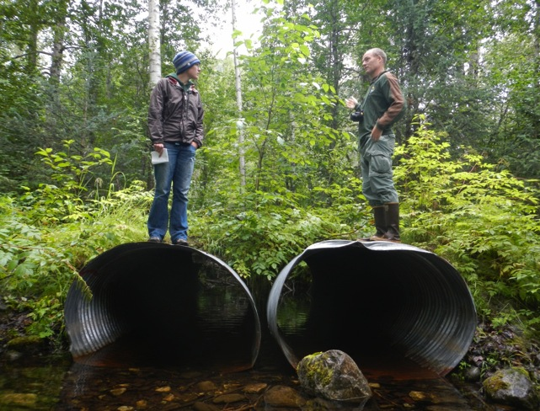
Skagway

Slide 20
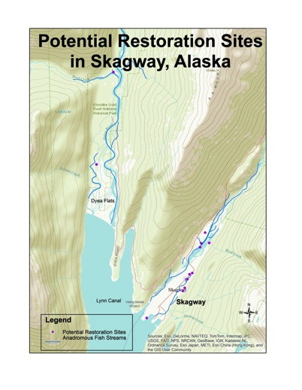
Skagway Sites
10 sites identified

Slide 21
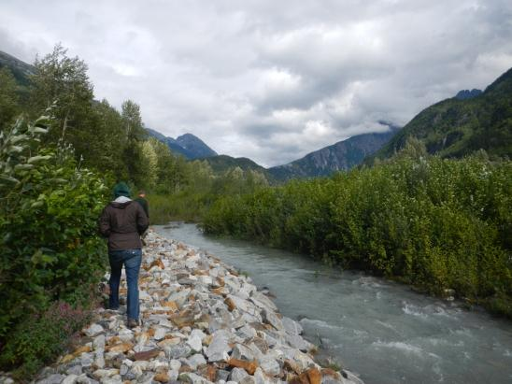
Case Study in Skagway: Revetment and Re-vegetation on the Skagway River
“GREEN”

Slide 22
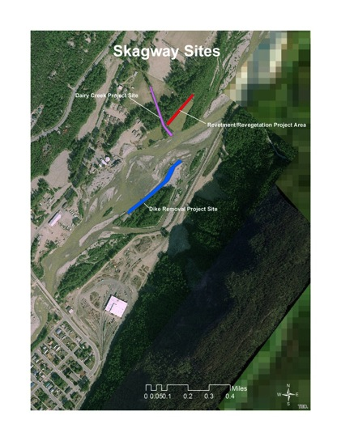
Site location on the Skagway River:
Revetment and
Re-vegetation Project area on Skagway River

Slide 23
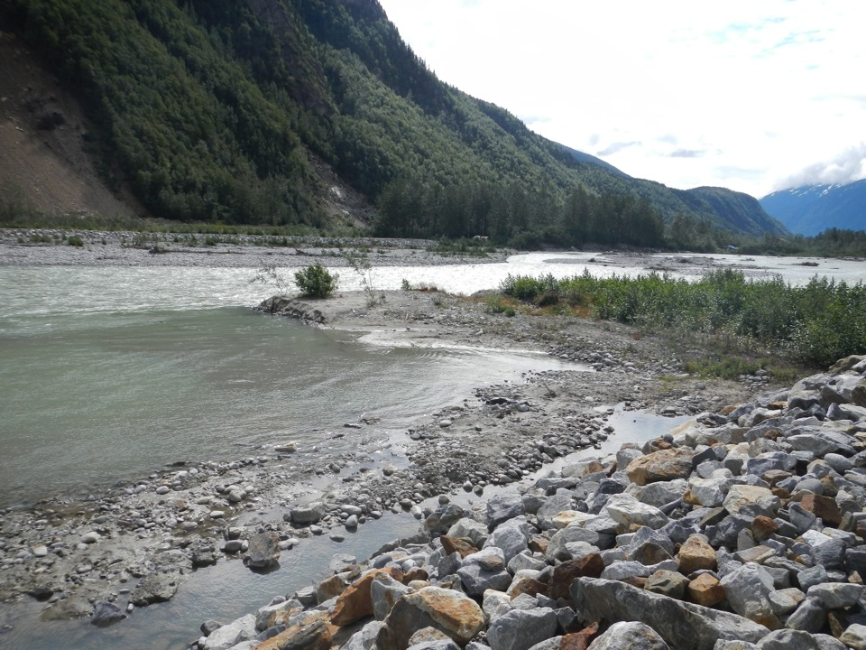
Revetment and
Re-vegetation on the Skagway River
Area along dike to add soil and red alders to the bank along revetment area.

Slide 24
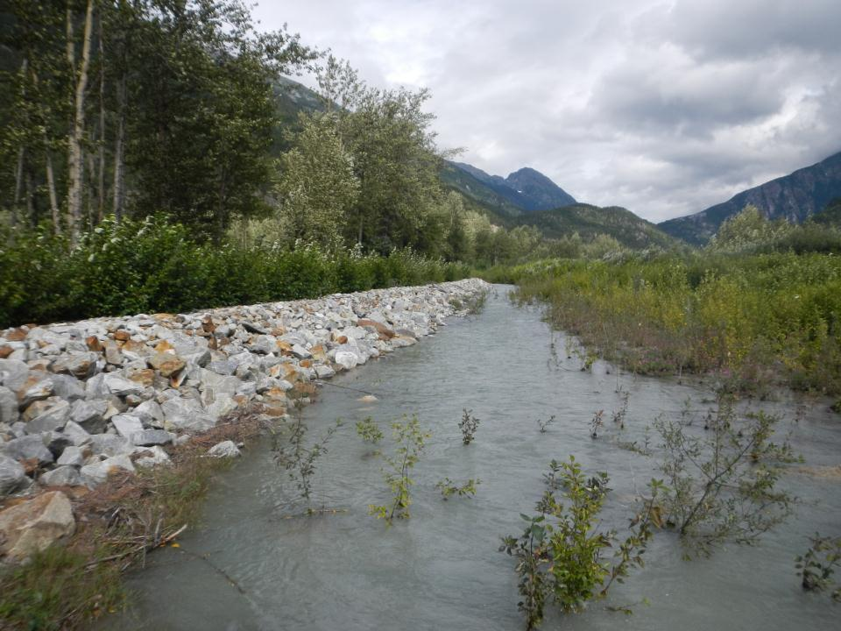
Functions to be restored:
Riparian functions
fish and wildlife habitat
organic matter input to streams
structural habitat restoration.

Slide 25
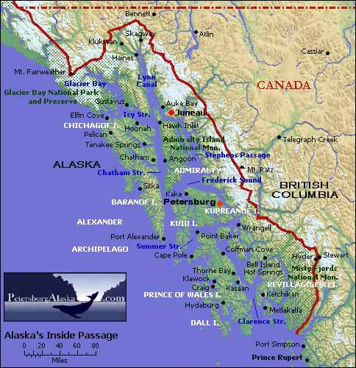
Where do we go from here?
Study Areas
Notes:
Instead of using this map lets use the map created of the 8 digit hucs. It is our goal to do this in each of the 8 digit hucs represented on this map– we would like to begin with the areas that are predicted to receive most impact, and continue on prioritizing in this fashion

Slide 26
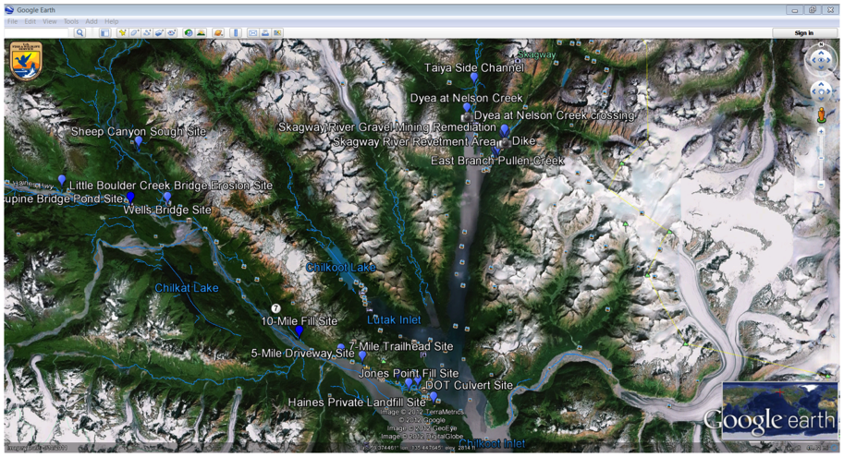
Using Google Earth as a user friendly way for the public to view mitigation projects

Slide 27
Lessons learned:
Best approach to identifying site: Communication with community groups to get local information is key.
Asking the right questions:
What is the history of the site?
What functions need to be restored?
What obstacles are involved with potential restoration?
Be prepared when going out to site: Have map of site with coordinates, project assessment form (can be partially filled out ahead of time), get permission from property owners prior to site visit and know site features ahead of time.

Slide 28
Contact Info…..
Melany Zimmerman
Southeast Alaska Watershed Coalition
(406) 529-5225
melany.alaskawatersheds@gmail.com
www.alaskawatershedcoalition.org

